Slide 1
Strategies to Enhance the Physical Recovery of
ICU Survivors
Daren K. Heyland
Professor of Medicine
Queens University, Kingston General Hospital
Kingston, ON Canada

Slide 2
Learning Objectives
Introduce the concept that muscle matters and methods to measure muscle and functional outcomes
Impact of macronutrition on clinically important muscle and other functional outcomes
Describe other methods to increase the retention of muscle mass/strength, so as to improve patient outcomes

Slide 3
Clinical Scenario
Moving Beyond Survival!
79 yo male admitted to hospital with AMI
Progressive respiratory failure
Aspirates ARDS
Low volume ventilation, high PEEP
Course complicated by line sepsis resulting in need for pressors and renal failure
@ 3 weeks, family asks “how much longer do we prolong this?”
“not just about survival; what will he be like?”

Slide 4
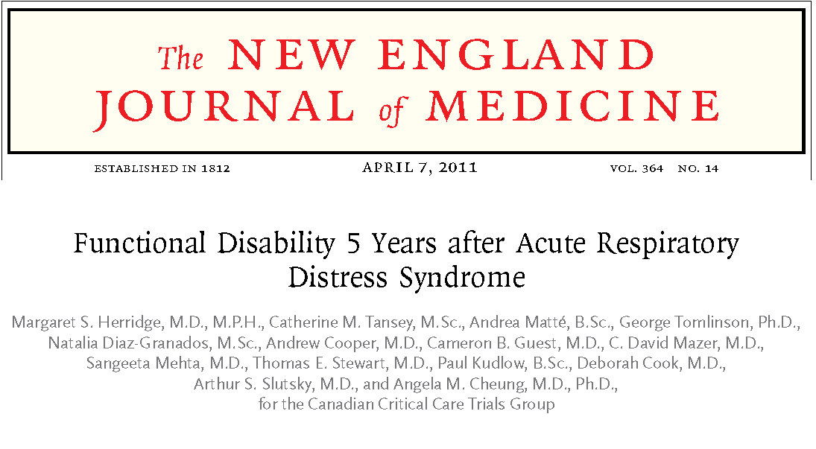

Slide 5
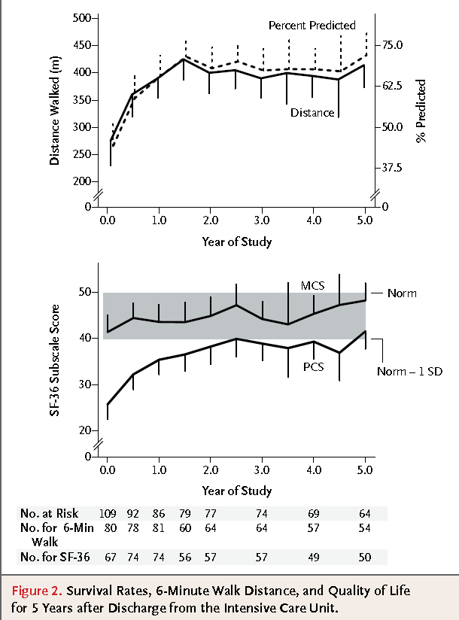

Slide 6
“clinically detected weakness in survivors of critical illness where there is no other cause noted except critical illness”
Both neuro and myo pathic process
Develops in 25%-100% of patients, higher in patient who have organ failure and prolonged mechanical ventilation
N Engl J Med 370;17

Slide 7
Acute outcomes and 1-year mortality of ICU-acquired weakness:
A cohort study and propensity matched analysis
ICU-acquired weakness shown to:
  delay weaning from mechanical ventilation,
  extend ICU and hospital stays,
  more healthcare related hospital costs and
  a higher risk of death at 1 year after ICU admission.
These data support causality of the association between weakness and poor outcomes
The data underscore the importance of identifying strategies to prevent/treat this debilitating problem
AJRCCM Published on 13-May-2014

Slide 8
Muscle Matters!
Determinants to Lean Body Mass

Slide 9
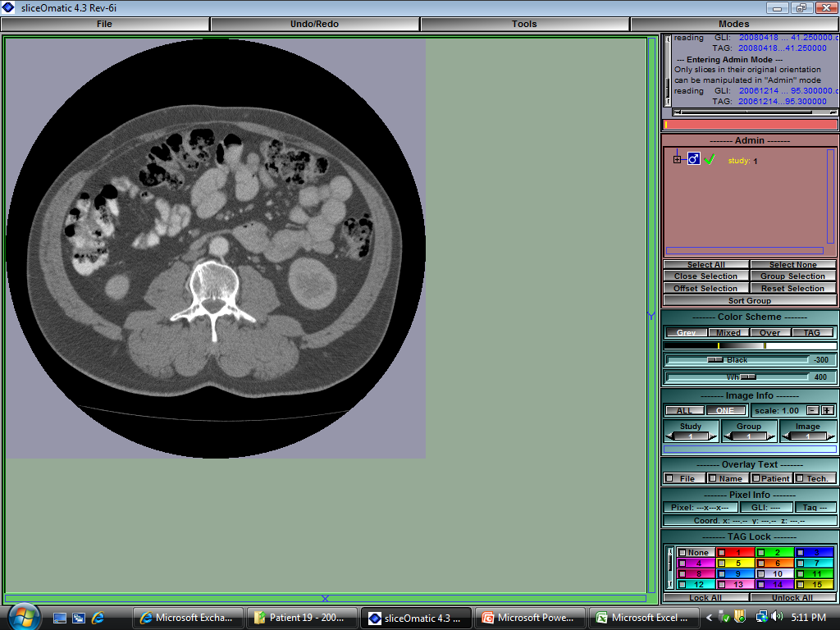
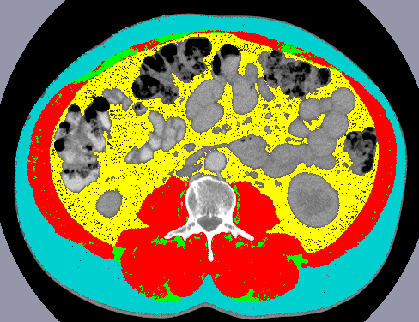
Body Composition Lab CT Analysis
Skeletal Muscle
Adipose Tissue
Images courtesy of Dr. Heyland
Notes:
To date we have used weight/BMI as a descriptor of patient body composition and we have looked at change in weight as a marker of change in nutritional status or to evaluate success/failure of nutritional intervention
However, with weight, we cannot discern specific body composition profile or changes in profile;
Use of already existing CT scans can provide this information…
-L3 bony landmark – literature; longitudinal

Slide 10
Skeletal Muscle is Related to Mortality in Critical Illness
149 80+ trauma patients
Prevalence of sarcopenia- 71% at baseline
Presence of sarcopenia associated with decreased ventilator-free days (P=0.004) and ICU-free days (0.002)
P=0.018
Moisey LL et al. Crit Care. 2013;17(5):R206.
Notes:
Multivariate linear regression showed that presence of sarcopenia decreased vent-free days and ICU-free days wehre BMI, fat and serum albumin did not.

Slide 11
Ultrasonography for Muscle Assessment
Need for a non-invasive, easily accessible, bedside tool to measure muscle quantity
Ultrasonography emerging as a potentially accurate tool for muscle quantification

Slide 12
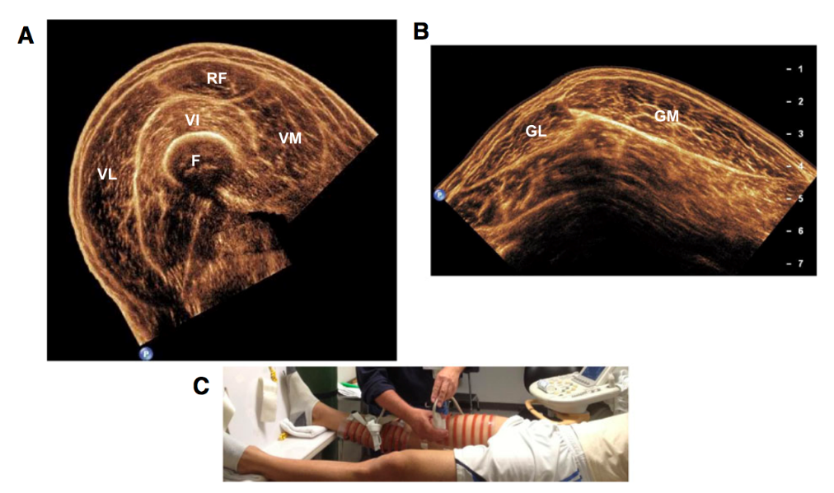
Ultrasonography for Muscle Assessment – Methodological Approaches
Several different approaches developed for muscle thickness
  1-site vs 3-site vs 4-site vs 5-site vs 9-site
  4-site most common
Excellent reliability^{1,2,3}
Few tested against reference methods
Fewer validated in the ICU to referent standards ²
1. Tillquist et al JPEN 2013
2. Paris et al JPEN 2016
3. Sarwal J Ultrasound Med 2015

Slide 13
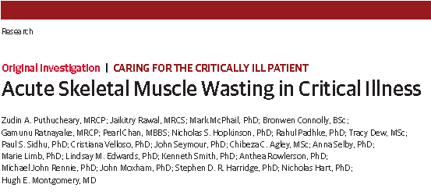
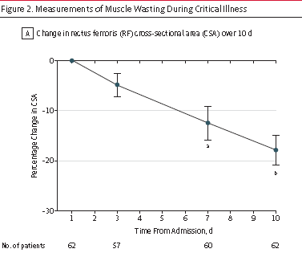
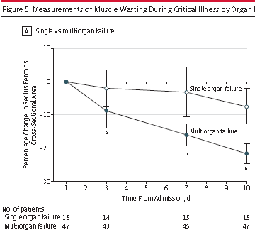
Loss of skeletal muscle protein = loss of function
JAMA Published online Oct 9, 2013

Slide 14
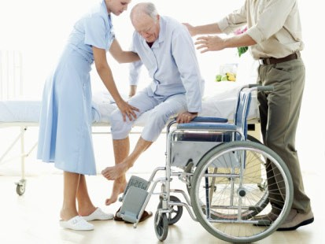
Low muscularity or Muscle Atrophy in the critically ill can lead to…
Physical Dysfunction
  Risk of falls / Potential fractures
  Impaired ability to perform ADL
  Functional disabilities
Metabolic Disorders
  Glycemic dysregulation
  Dyslipidemia
Immune dys-function
  Infection
  Complications
Poor Clinical Outcomes
  Mortality
  ICU LOS / Hospital LOS
  Hospital Complications
Notes:
Several metabolic/physiologic problems are related to muscle atrophy or low muscularity.

Slide 15


Intensive Care Medicine 2017

Slide 16

Does increasing protein delivery impact outcomes?

Slide 17
What happens to exogenously administered
amino acid?
Olav Rooyakers CC. icu-metabolism.se

Slide 18
Effect on Nitrogen Balance?
249 trauma patients receiving nutrition support
Dickerson J Trauma Acute Care Surg 2012

Slide 19
What is the evidence that exogenously administered amino acids/protein favorably impacts muscle mass and function?
RCT of 119 ICU patients requiring PN
Randomized to 0.8 gram/kg/day vs. 1.2 grams/kg/day IV aa
Ferrie JPEN 2016

Slide 20
What is the evidence that exogenously administered amino acids/protein favorably impacts muscle mass and function?
No impact on LOS or mortality
Ferrie JPEN 2016

Slide 21
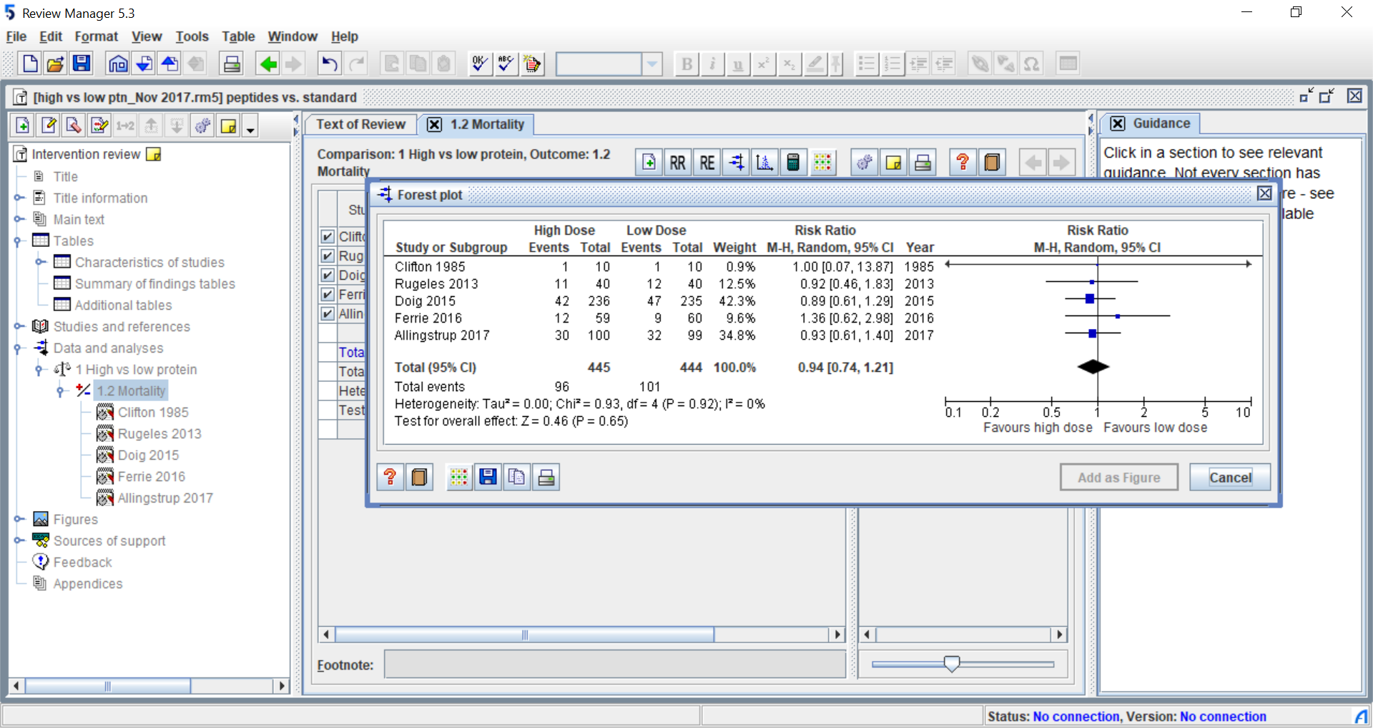
Systematic Review of RCTs of
High vs. Low Dose Protein
Heyland JPEN (Under review)

Slide 22



RCTs do not suggest any evidence of harm and observational studies suggest increased protein intake associated with…
Reduced mortality¹
Quicker Time-to-discharge-alive¹
Greater preservation of muscle ^{2,3}
Reduced infection ⁴
Increased mortality⁵
Slower time-to-discharge-alive from ICU⁶
Greater loss of muscle mass and increased weakness^{7,8}
5 Braunschweig Am J Clin Nutr 2017
1 Nicolo JPEN 2015
2 Ferrie JPEN 2016
6 Casaer Am J Respir Crit Care Med 2013
7 Puthucheary JAMA 2013
3 Fetterplace JPEN 2018
8 Hermans Lancet Respir 2013
4 Heyland JPEN 2010

Slide 23
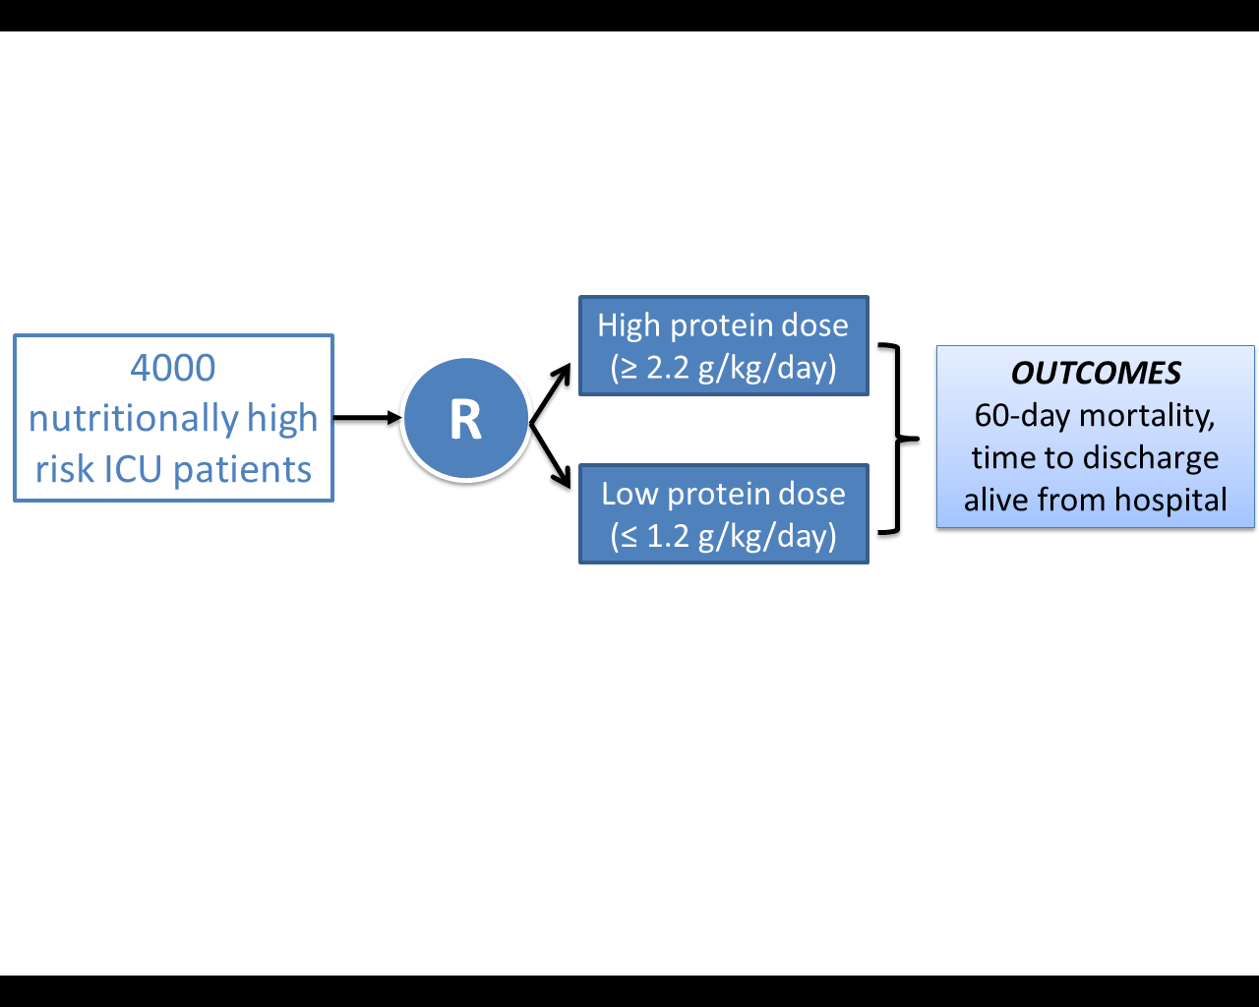
The Effect of Higher Protein Dosing
in Critically Ill Patients:
The EFFORT Trial
Higher protein
dose
( > 2.2 g/kg/d)
4000
Nutritionally high
risk ICU patients
Target >2.2 gram/kg/day
OUTCOMES
60-day mortality,
time to discharge
alive from hospital
R
Primary Outcome
4000 ICU patients
R
Stratified by:
Site
BMI
Med vs Surg
Usual protein
dose
( < 1.2 g/kg/d)
Fed enterally
60 day
mortality
Target <1.2 gram/kg/day
A multicentre, pragmatic, volunteer-driven, registry-based, randomized, clinical trial.
475 patients randomized to date; 1 site from Russia- would like more!!
See our website www.criticalcarenutrition.com
Notes:
.jen, please update enrollment as of wed.

Slide 24
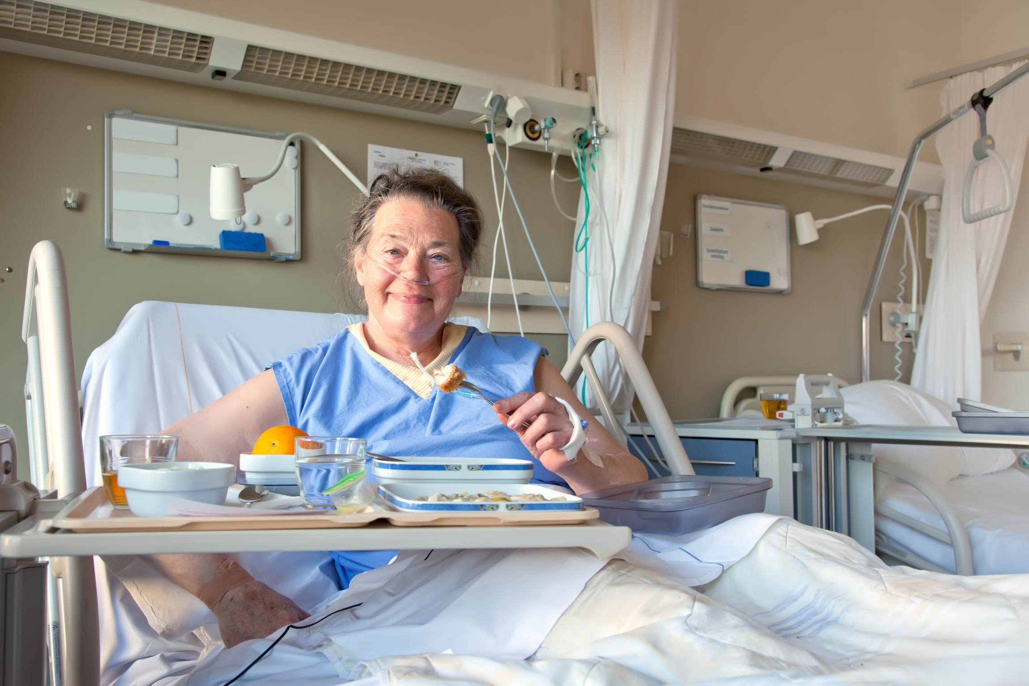
More Protein may be Associated
with Improved
Functional Recovery???
If you feed
them better,
They may will
leave sooner?

Slide 25
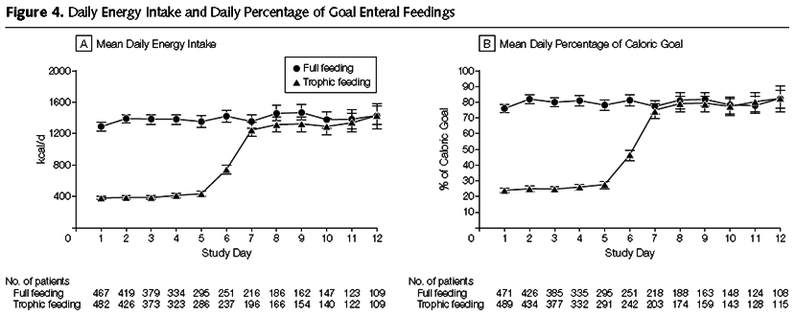
Initial Tropic vs. Full EN in Patients with Acute Lung Injury
The EDEN randomized trial
Rice TW, et al. JAMA. 2012;307(8):795-803.

Slide 26
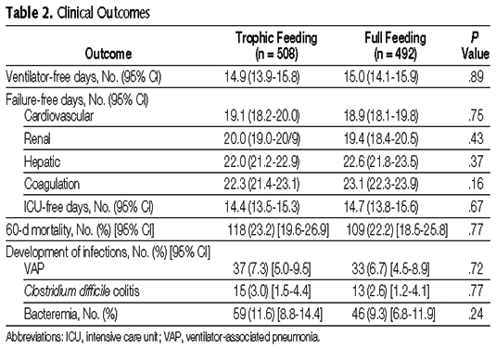
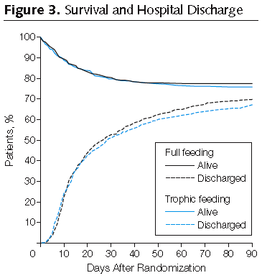
Initial Tropic vs. Full EN in Patients with Acute Lung Injury
The EDEN randomized trial
Rice TW, et al. JAMA. 2012;307(8):795-803.

Slide 27
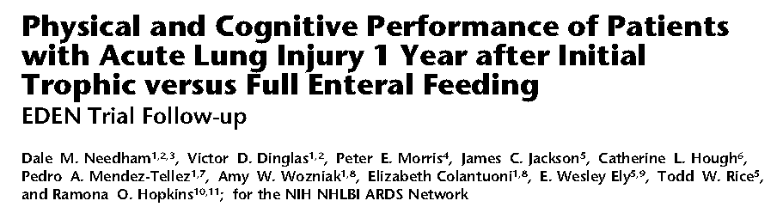
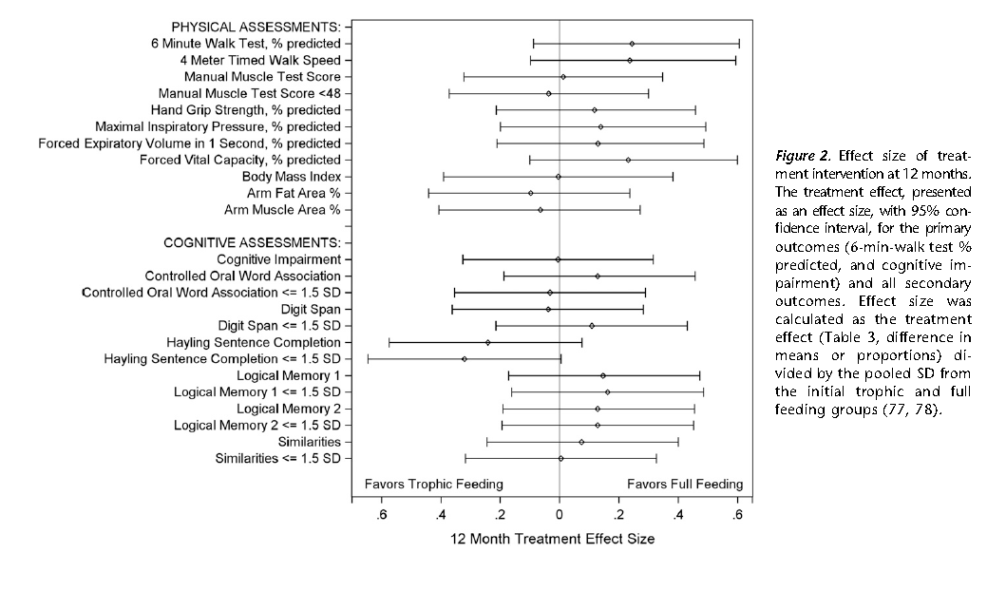

Slide 28
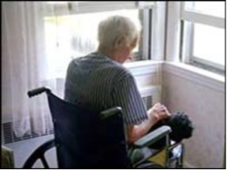
Trophic vs. Full enteral feeding in critically ill patients with acute respiratory failure
“survivors who received initial full-energy enteral nutrition were more likely to be discharged home with or without help as compared to a rehabilitation facility (68.3% for the full-energy group vs. 51.3% for the trophic group; p = .04).”
Rice CCM 2011;39:967

Slide 29
Nutritional Adequacy and Long-term Outcomes in Critically Ill Patients Requiring Prolonged Mechanical Ventilation
Sub study of the REDOXS study
302 patients survived to 6-months follow-up and were mechanically ventilated for more than eight days in the intensive care unit were included.
Nutritional adequacy was obtained from the average proportion of prescribed calories received during the first eight days of mechanical ventilation in the ICU.
HRQoL was prospectively assessed using Short-Form 36 Health Survey (SF-36) questionnaire at three-months and six-months post ICU admission.
Wei CCM 2015

Slide 30
Estimates of association between nutritional adequacy and SF-36 scores
*Every 25% increase in nutritional adequacy; adjusted for age, APACHE II score, baseline SOFA, Functional Comorbidity Index, admission category, primary ICU diagnosis, body mass index, and region

Slide 31
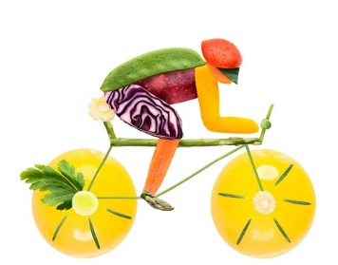
How to get bigger bang for your buck!
Combination of Nutrition and exercise!

Slide 32

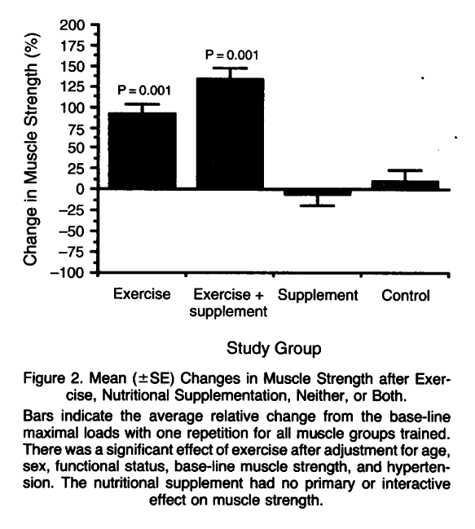
Exercise Training and Nutritional Supplementation for Physical Frailty in Very Elderly People
Fiatarone, NEJM 1994;330:1769-1775.
Notes:
As we think about the physical recovery of our patients… evidence that it is the combination of ….. But what do you as dietitians know about activity/exercise? What do you our rehabilitation partners know about nutrition.

Slide 33
This systematic review summarizes the effect of combined exercise and nutrition intervention on muscle mass and muscle function.
A total of 37 RCTs were identified.
Results indicate that physical exercise has a positive impact on muscle mass and muscle function in subjects aged 65 years and older.
However, any interactive effect of dietary supplementation may be modest

Slide 34
↑ Interest in exercise in the ICU
Research suggests:
  Improved physical function, strength, 6MWD, return to independent function
  Decreased ventilator days, ICU & hospital LOS, delirium
However…
  Most studies are single center and small
  Highly variable exercise intervention
  Inconsistent signal
Schweickert Lancet 2009; Morris CCM 2008; Burtin CCM 2009; Denehy CC 2013; Kayambu CCM 2013

Slide 35
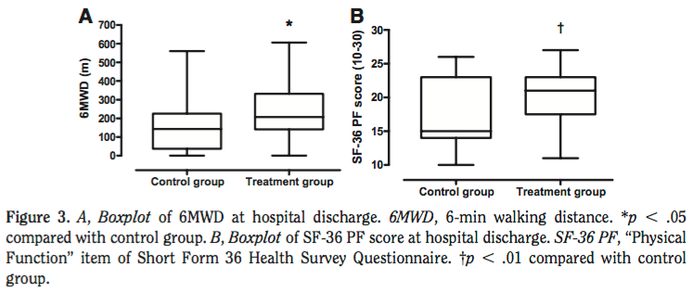
Cycling in the ICU
Burtin CCM 2009
Notes:
~70 in the whole RCT

Slide 36
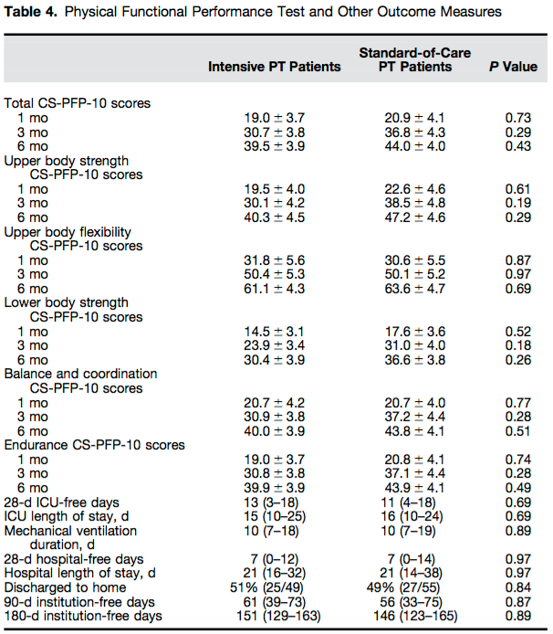
Exercise in the ICU
Moss AJRCCM
2016
Notes:
~70 in the whole RCT

Slide 37
Key ICU Rehab clinical trials
Study Year | N | ICU # Type | Country | Interv. Timing |  | Outcomes
Morris 2008 | 280 | 1 MICU | USA | <2 day | + | Decreased duration of ICU & hospital stay Earlier PT consult in ICU & out of bed
Schweickert 2009** | 104 | 2 MICU | USA | <2 day | + | Improved physical function at hospital D/C Decreased duration of MV & delirium
Schaller 2016** | 200 | 5 SICU | USA EU | <3 day | + | Increased ICU mobilization & func. at hosp D/C Decreased duration of ICU & delirium
Hodgson 2016 | 50 | 5 MS-ICU | AUSNZ | 3 (2-4) | + | Increased mobility score & milestones in ICU No dif: MV, LOS; d/c location, 6 mo. outcomes
Morris 2016** | 300 | 1 MICU | USA | ~4 - 6 | ? | No difference: hospital LOS; strength Increased at 6 mo: phys func (SPPB, SF-36, FPI)
Denehy 2013 | 150 | 1 MS-ICU | AUS | 7(5-11) | - | No difference at 12 mo: 6MWD, TUG, SF-36 PF (Control - PT during MV: 52% out of bed)
Moss 2016** | 120 | 5 MICU | USA | 6 - 11 | - | No dif: phys func (to 6 mo); MV, ICU, hosp LOS (Control - PT during MV: 20 min., 3x week)
Wright 2017 | 308 | 4 MS-ICU | UK | ~8 | - | No difference to 6 mo: SF-36, Grip, 6MWT, LOS (Control - PT during MV: 10 min/d less than interv

Slide 38
in bed cycling + NMES
Primary Outcome
314 ICU
Patients
Expected >48 hrs
In ICU
R
MRC Muscle Strength of Quads
Usual care
(standard rehabilitation which include
“Schwiekert protocol” for early mobilization)

Slide 39
No differences in other clinical outcomes!

Slide 40
Healthy patients (barthel=100)
early mobilization started in both groups within 30 hrs (usual care)
No weekend coverage so the intervention was missed for one day of first 3 days in 1/3 patients
Cycling was all passive (no resistance); only 15 mins (compared to 45 in NEXIS)
No physical or functional assessment post ICU
No mention of nutrition intake
In settings where expert PT with early mobilization program, taking well patients and applying a low intensity rehab intervention ineffective
Notes:
Need to finish

Slide 41

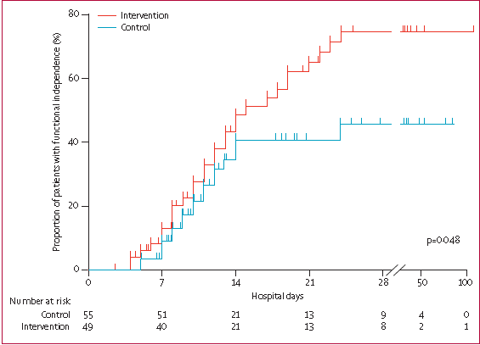

Lancet 2009;273:

Slide 42
Combined Exercise and Protein
In other populations, protein + exercise improves outcomes vs. either alone
  Older people: improved strength & protein synthesis
  Obesity, HIV/AIDS, COPD, healthy adults of all ages: improved muscle mass & strength
Combo not studied in critically ill patients but has strong rationale
Symons 2011; English 2010; Tieland 2012; Bonnefoy 2003; Fiatarone 1994; Villareal 2011; Botros 2012

Slide 43
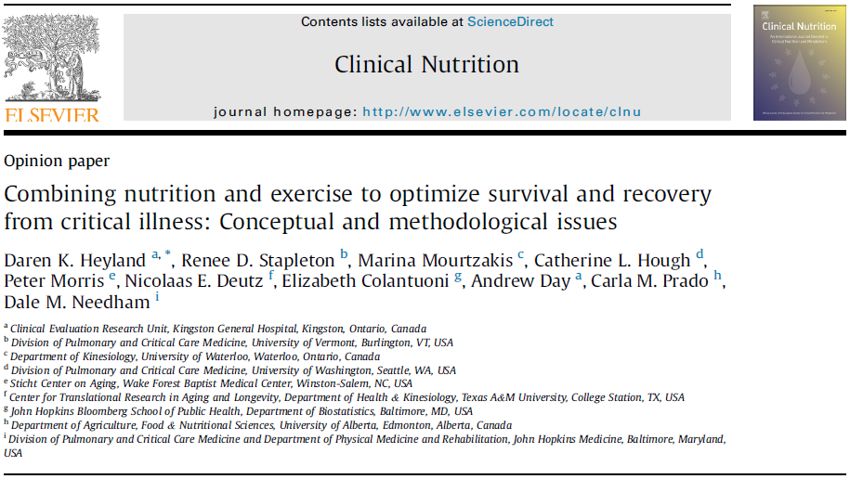
NEXIS Concept

Slide 44

NEXIS Trial
Phase II RCT of combined IV amino acid supplementation and early in-bed cycle ergometry exercise versus usual care
NHLBI, April 2017 – March 2022
PIs Heyland, Needham, Stapleton
  4 sites: UVM, Hopkins, Wake Forest, Harborview (U Washington)
  Enrollment began Fall 2017

Slide 45

Arm 1: Combined Intervention (In-bed cycling and Amino Acid Supplementation)
Arm 2: Usual Care
142 mechanically ventilated ICU patients expected to stay > 4 days
Physical function Outcomes and Body Composition Assessments
6MWT, Physical Function Outcomes and Body Composition Assessments
Patient Reported Outcomes, Health Care Utilization and Survival Status
ICU Admission
Randomization
ICU Discharge or 21 days in ICU
Hospital Discharge
6 Month Following Randomization
≤ 96 hrs from time of ICU admission to Randomization
Figure 1. Study Design

Slide 46
Protein Intervention
On top of standard EN, patients receive 1.0-1.5 g/kg/day IV infusion of 15% amino acid solution (goal is total protein 2.5g/kg/day)
  Dosed by IBW and adjusted daily to target
  Delivered during/after cycling over <18hr
    At least 5 days per week on same days as cycling
  Peripheral option (7.5%)
Stop at ICU discharge or 21 days
Recommended feeding strategy to obtain dietitian consult and start EN within 48 hrs

Slide 47
In-bed Cycle Ergometry Exercise Intervention
45 min/day, at least 5 days/week
  Motomed Letto 2 cycle
    Default speed = 10 RPM, initial gear = 0
  Verbally encourage active cycling
  Detailed protocol for warm up, training with increasing gear if active cycling, cool down
  Rules for stopping session
Stop at ICU discharge or 21 days
No protocolization of “standard” rehab/exercise at study sites
Kimawi, Phys Ther J 2017

Slide 48
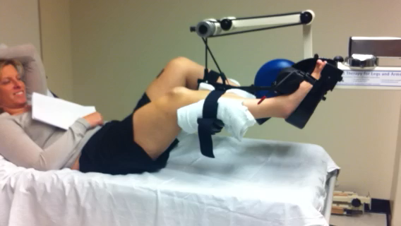
Exercise Intervention
Notes:
Renee- we flipped this video since it was paying upside down

Slide 49
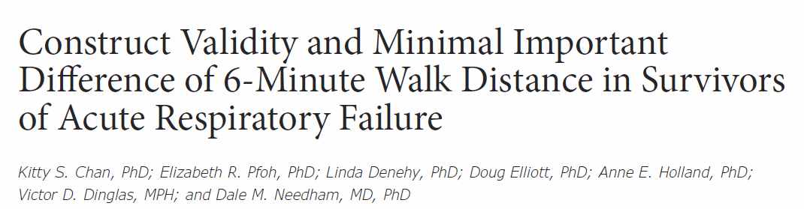
Primary Outcome
6 minute walk distance at hospital discharge

Slide 50
Secondary Outcomes
Domain | Secondary Outcome Measure/Tool
Survival | Mortality
Activity Limitations within a Standardized Setting (in-hospital) | FSS-ICU (Functional Status Score for the ICU) SPPB (Short Phys. Perf. Battery) – incl. 4 meter walk
Standard ICU/Hospital Outcomes | ICU/hospital LOS Hospital-acquired infections Discharge location Health care utilization including ICU readmission & reintubation
Quality of Life (6 mo.) | SF-36 v2 and EQ-5D-5L
Mental Health and Cognitive function (6 mo.) | HADS, IES-R and MoCA-BLIND
Participation/Restriction in Usual Environment (6 mo.) | ADL/IADL Time to return to work/prior activity Living location
Notes:
Dmn – swap the order of QOL and MH/cognitioin rows
Note to Renee: this slide was updated to include COS surveys which are in red

Slide 51
Secondary Outcomes
Domain | Secondary Outcome Measure/Tool
Structure and Function (ICU and hospital discharge) | Amino acid metabolism (tracer studies, select subset) Body Composition Rectus femoris ultrasound Deuterium dilution studies (select subset) CT of 3rd lumbar vertebra (clinical available) Muscle strength Quadriceps force MRC sum-score (UE/LE muscle groups) Hand grip strength

Slide 52
Sample Size
128 evaluable patients
  Based on rank-based sample size calculation
    Death = -1
    Cannot perform test = 0
  Traditional calculation: 80% power to detect difference in 6MWD of 50m with α=0.05
Expect 10% non-participation rate (i.e. alive but not willing to do test) so will enroll 142 patients
4 clinical enrolling sites for 4 years

Slide 53
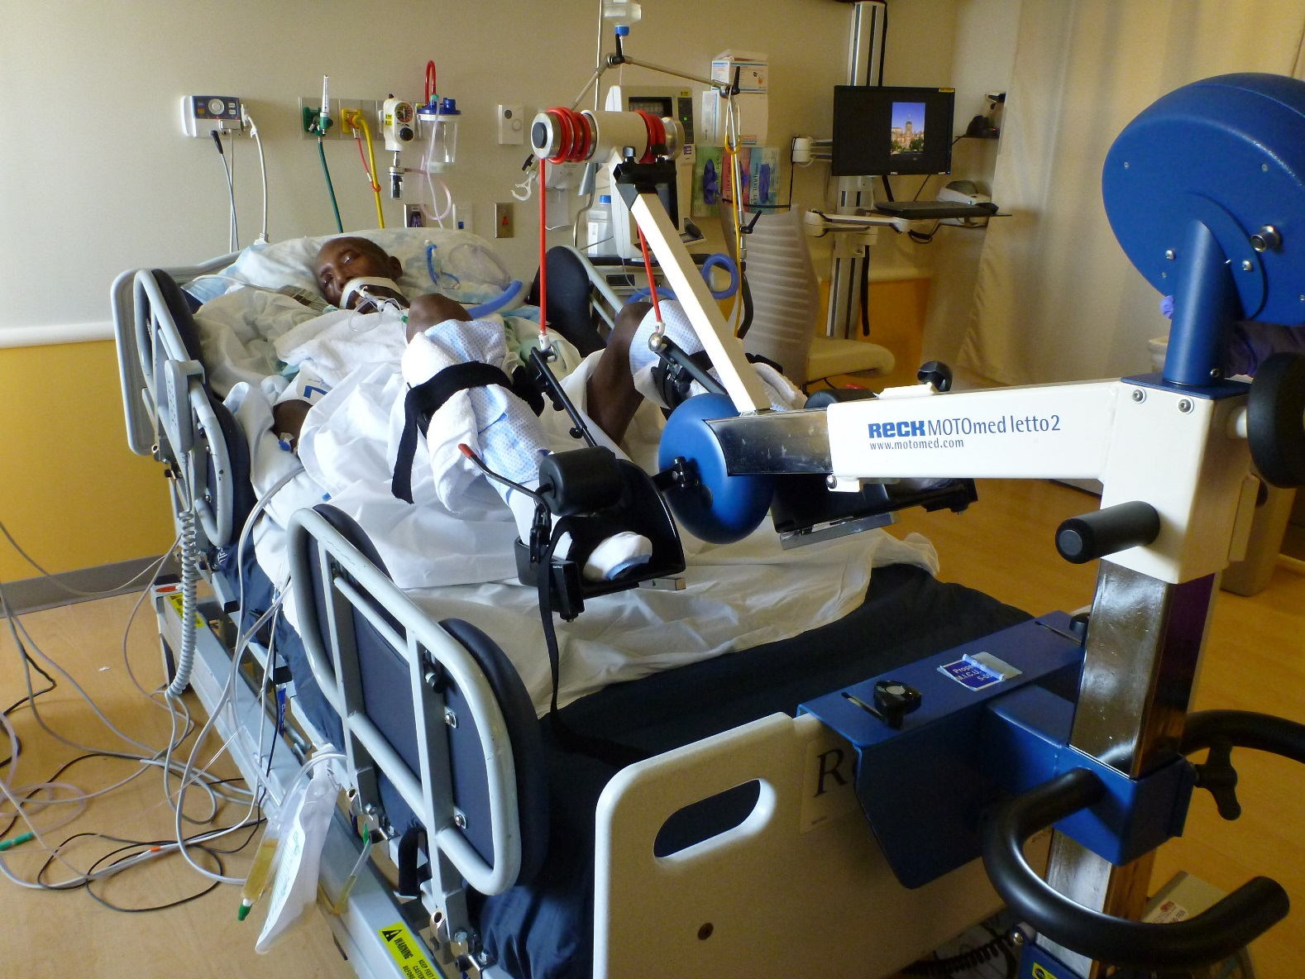
Apply the NEXIS concept to:
Sub-study of EFFORT trial
LVAD patients
High-risk Cardiac Surgery patients

Slide 54
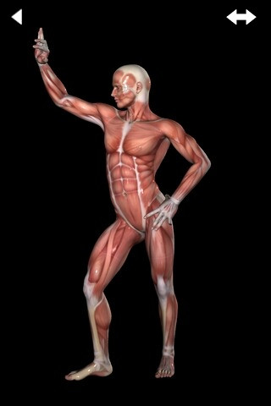
Other Strategies to Preserving Muscle and Optimizing Outcomes
HMB/Leucine
Growth Hormone
Ghrelin agonists
Oxandrolone
IGF-1
others

Slide 55
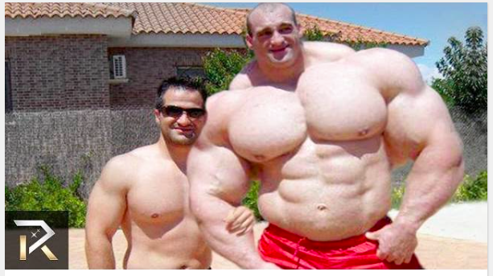
Liberal Protein, Exercise and anabolic agents!
Former ICU Survivors

Slide 56
Conclusions
• Muscle Matters
Increased protein intake may help preserve muscle mass/function?
  More trials needed- join the EFFORT collaborative!
Combining nutrition with exercise or other pharmacological strategies that promote anabolism will increase treatment effect
Consider more relevant patient reported-outcomes and functional assessments in evaluating the impact of nutrition and rehab interventions.
Notes:
Need to finish

Slide 57

Evaluation Framework for Interventional Studies Designed to Aid in the Recovery of ICU Patients
Baseline Status
Including Physiology, Function, Disability, and Quality of Life
Should be Assessed with Tools that Parallel those to be used after Acute Illness
Acute
Illness
Interventions
Pathology and Impairment during illness
Assessment of structure and Function in ICU:
e.g. Protein balance, muscle mass, biopsy, nerve conduction studies, etc.
Activity Limitations Following Illness
Assess Activities in a Standardized Research Environment (Prior to hospital discharge)
e.g. 6 MWD, TUG, grip strength, etc.
Participation Restriction
Assess Participation in Usual Environment (following hospital discharge) e.g. SF-36 Physical Function domain, IADL, ADL, etc.
Quality of LIfe
Assess Holistic QOL in Usual Environment (6-12 months later) : e.g. EQ-5D, SF-36, etc.
Heyland Clin Nutr 2015

Slide 58
Thank you

